Slide 1
BUAN 6356 BA with R
k Nearest Neighbors and Collaborative Filtering

Slide 2
Agenda
Administrative
Homework due prior to the start of class on February 18th
Data Camp
Interactive R tutorials
Collaborative Filtering

Slide 3
Primary Methods for Recommender Systems
Association Rules
Useful for frequently bought items
Collaborative Filtering
Useful for infrequently bought items and frequently bought items

Slide 4
Collaborative Filtering

Slide 5
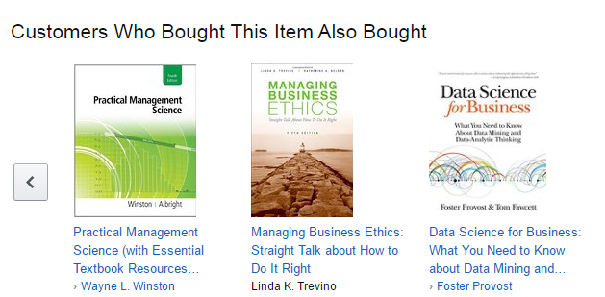
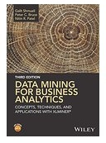
Collaborative Filtering
Item based methods
User based methods
Source: Data Mining for Business Analytics (3rd ed.) by Shmueli, Bruce & Patel

Slide 6
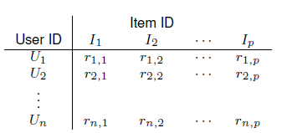
Item-user matrix
Cells are user preferences, r_{ij}, for items
Preferences can be ratings, or binary (buy, click, like)
Source: Data Mining for Business Analytics (3rd ed.) by Shmueli, Bruce & Patel

Slide 7
Measures of Similarity
Distance
Correlation

Slide 8
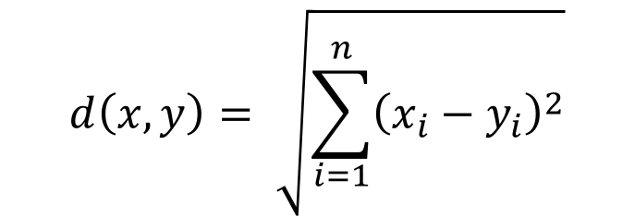
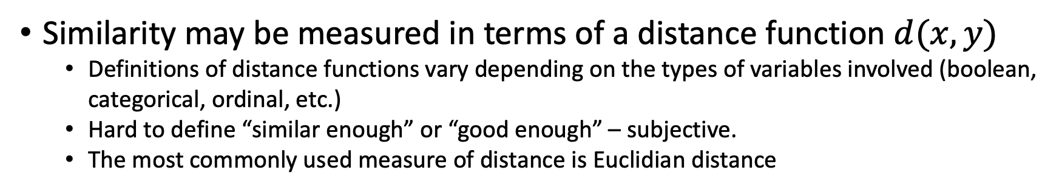
Similarity Measure - Distance
Similarity may be measured in terms of a distance function $d(x, y)$
Definitions of distance functions vary depending on the types of variables involved (boolean, categorical, ordinal, etc.)
Hard to define “similar enough” or “good enough” – subjective.
The most commonly used measure of distance is Euclidian distance
$$d\left(x,y\right)= \sqrt{\sum_{i=1}^{n}{{\left(x_{i}−y_{i}\right)}^{2}}}$$

Slide 9
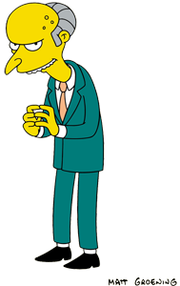
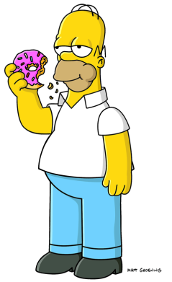
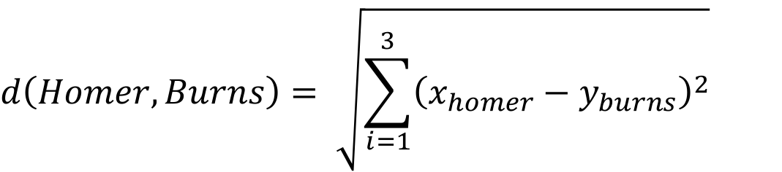
Distance Function for Multiple Variables
Homer
Age: 38
Income: $50,000
# of credit cards: 5
Mr. Burns
Age: 97
Income: $1,000,000
# of credit cards: 0
$$d\left(Homer,Burns\right)= \sqrt{\sum_{i=1}^{3}{{\left(x_{homer}−y_{burns}\right)}^{2}}}$$
$$d\left(Homer,Burns\right)= \sqrt{{\left(38−97\right)}^{2}+{(50,000 −1,000,000)}^{2}+ {(5 −0)}^{2}}$$
$$d\left(Homer,Burns\right)≈950,000$$

Slide 10

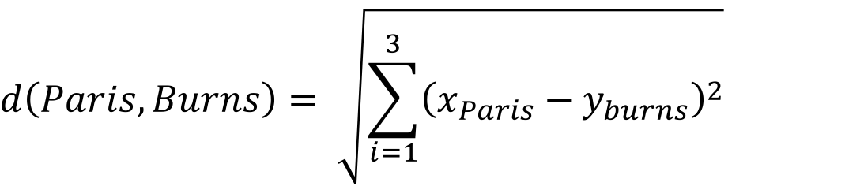
Distance Function
Paris Texan
Age: 22
Income: $1,000,000
# of credit cards: 10
Mr. Burns
Age: 97
Income: $1,000,000
# of credit cards: 0
$$d\left(Paris,Burns\right)= \sqrt{\sum_{i=1}^{3}{{\left(x_{Paris}−y_{burns}\right)}^{2}}}$$
$$d\left(Paris,Burns\right)= \sqrt{{\left(22−97\right)}^{2}+{(1,000,000 −1,000,000)}^{2}+ {(10 −0)}^{2}}$$
$$d\left(Paris,Burns\right)≈75.67$$

Slide 11
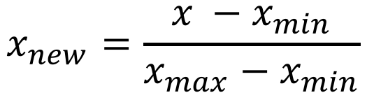

Standardize the Data
Two common methods
Normalization:
Scaling to [0, 1]:
$$x_{new}=\frac{x −μ}{ℴ}$$
$$x_{new}=\frac{x −x_{min}}{x_{max}−x_{min}}$$

Slide 12
Distance Calculation in Excel

Slide 13
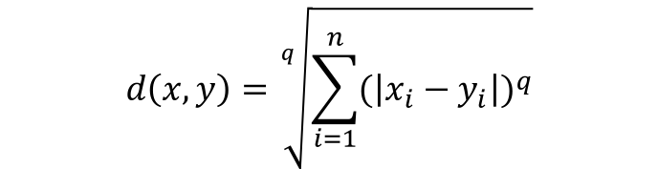
Similarity Metric
Euclidian distance is a special case of Minkowski Distance
$$d\left(x,y\right)=\sqrt[q]{\sum_{i=1}^{n}{{(\left|x_{i}−y_{i}\right|)}^{q}}}$$
$$d\left(x,y\right)=\sqrt[q]{{(\left|x_{1}−y_{q}\right|)}^{q}+ {(\left|x_{2}−y_{2}\right|)}^{q}+…+{(\left|x_{n}−y_{n}\right|)}^{q}}$$
When q = 2, we have Euclidian distance
When q = 1, d(x, y) is called Manhattan distance
a
Manhattan distance is the sum of Sum of these
Euclidean distance
b
c

Slide 14
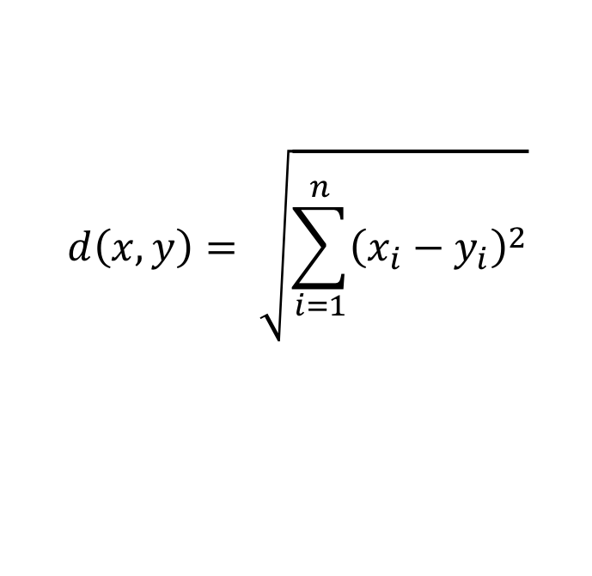
Measures of Distance
Euclidean Distance – Most Common
$$d\left(x,y\right)= \sqrt{\sum_{i=1}^{n}{{\left(x_{i}−y_{i}\right)}^{2}}}$$

Slide 15
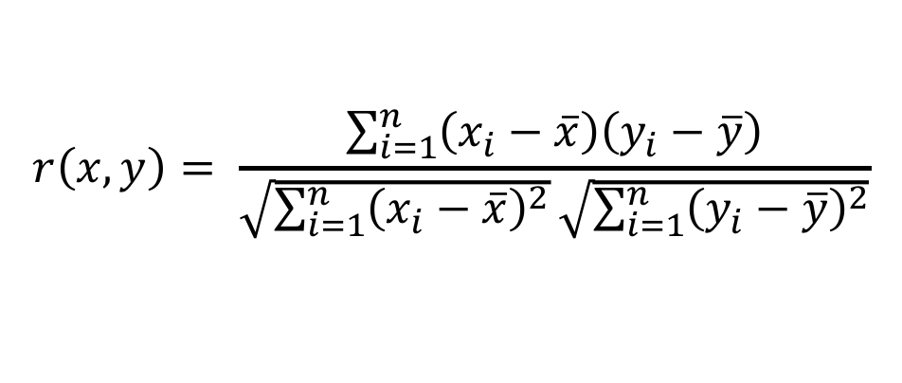
Measures of Similarity – Pearson Correlation
Pearson Correlation
Used to “measure the strength of an association between variables”
$$r\left(x,y\right)= \frac{\sum_{i=1}^{n}{\left(x_{i}−\overline{x}\right)\left(y_{i}−\overline{y}\right)}}{\sqrt{\sum_{i=1}^{n}{{\left(x_{i}−\overline{x}\right)}^{2}}}\sqrt{\sum_{i=1}^{n}{{\left(y_{i}−\overline{y}\right)}^{2}}}}$$
Source: https://www.socscistatistics.com/tests/pearson/

Slide 16
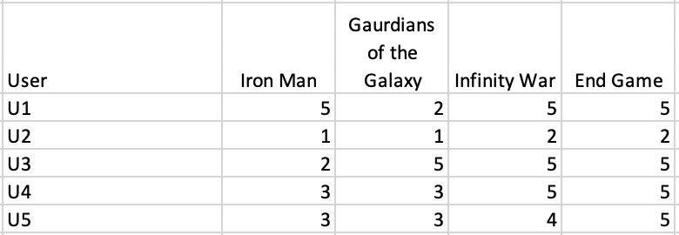
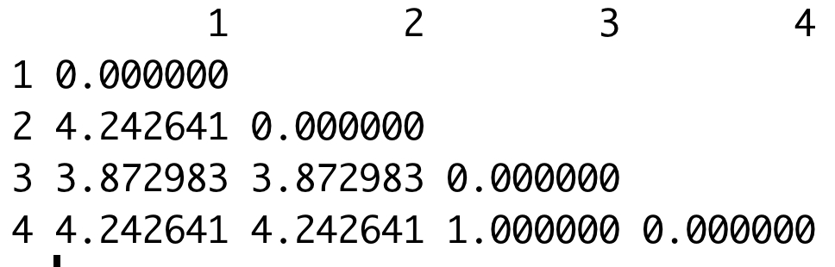
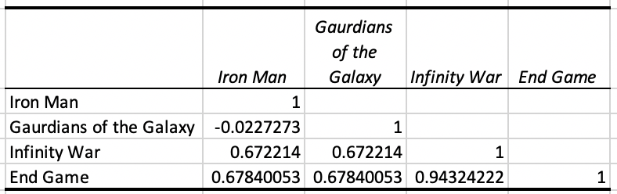
Movie Similarity Using Distances and Correlations
Distance
Correlation

Slide 17
Collaborative Filtering
Item-based – for a new user considering an item, find k other items that are most similar
Ability to calculate item-item correlations in advance greatly speeds up the algorithm
User-based – for a new user, find other k user(s) who share his/her preferences, recommend the item with the highest rated average that new user does not have.
User-user correlations cannot be calculated until new user appears on the scene
Source: Data Mining for Business Analytics (3rd ed.) by Shmueli, Bruce & Patel

Slide 18
Item Based Collaborative Filtering

Slide 19
Item Based Approach
Given an item, identify k-nearest items
Proximity or distance can be used as a measure of similarity
Correlation may also be used and it tends to work better than distance for this situation
Calculate correlation for all item pairs to identify k-nearest items
Correlation can measure ratings or purchases
That “best” item(s) is/are the recommendations for the user
Source: Data Mining for Business Analytics (3rd ed.) by Shmueli, Bruce & Patel

Slide 20
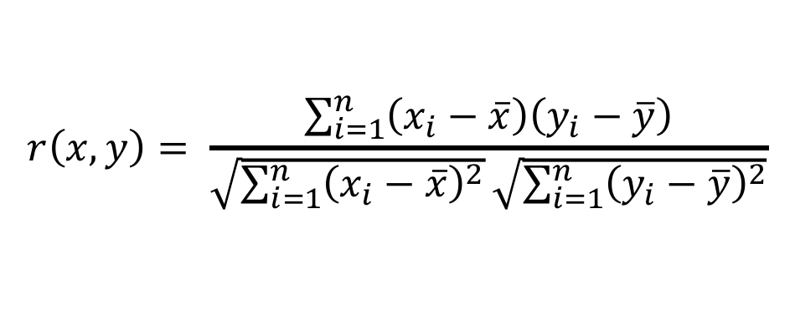
Measuring Proximity
Use Pearson Correlation
For each item pair, find the co-rated items, calculate correlation between the vectors of their ratings for those items
Note that the average ratings for each item are across all ratings, not just the co-rated ones
$$r\left(x,y\right)= \frac{\sum_{i=1}^{n}{\left(x_{i}−\overline{x}\right)\left(y_{i}−\overline{y}\right)}}{\sqrt{\sum_{i=1}^{n}{{\left(x_{i}−\overline{x}\right)}^{2}}}\sqrt{\sum_{i=1}^{n}{{\left(y_{i}−\overline{y}\right)}^{2}}}}$$
Source: Data Mining for Business Analytics (3rd ed.) by Shmueli, Bruce & Patel

Slide 21
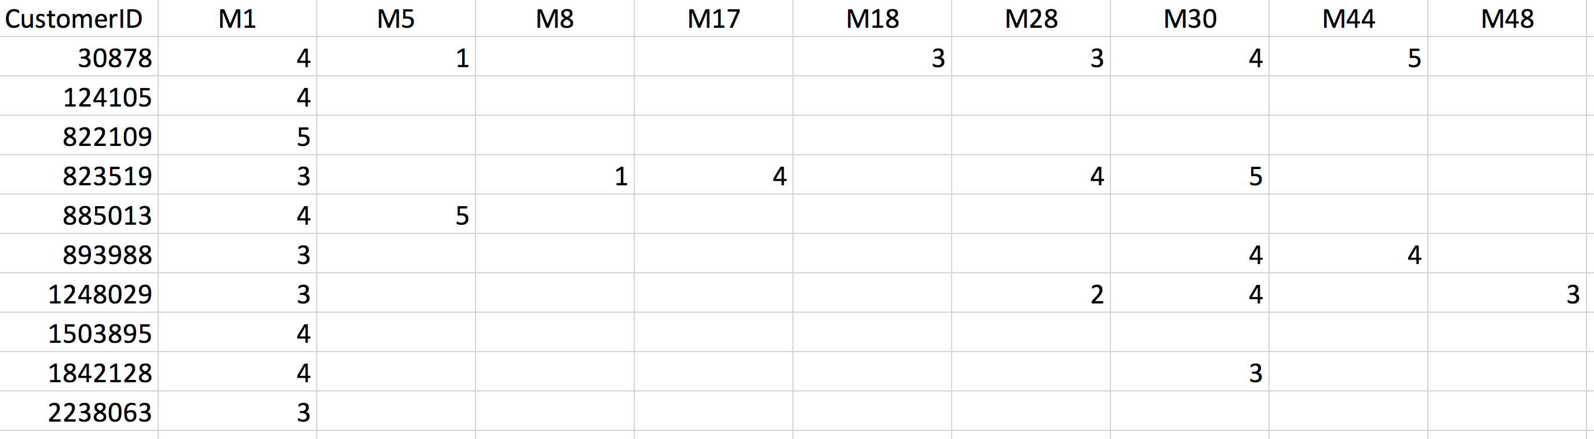
Tiny Netflix Dataset

Slide 22
User Based Collaborative Filtering

Slide 23
User-based Collaborative Filtering
Start with a single user who will be the target of the recommendations
Find other users who are most similar, based on comparing preference vectors
Source: Data Mining for Business Analytics (3rd ed.) by Shmueli, Bruce & Patel

Slide 24

Measuring Proximity
Correlation proximity does better (Pearson)
For each user pair, find the co-rated items, calculate correlation between the vectors of their ratings for those items
Note that the average ratings for each user are across all products, not just the co-rated ones
Source: Data Mining for Business Analytics (3rd ed.) by Shmueli, Bruce & Patel

Slide 25
Tiny Netflix Dataset
Consider users 30878 and 823519

Slide 26

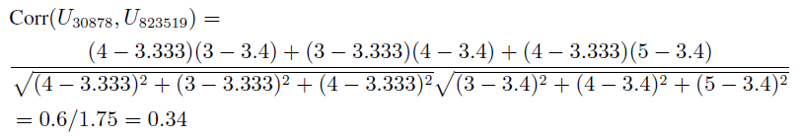
Correlation between users 30878 and 823519
First find average ratings for each user:
Find correlation using departure from avg. ratings for the co-rated movies (movies 1, 28 and 30):
Source: Data Mining for Business Analytics (3rd ed.) by Shmueli, Bruce & Patel

Slide 27
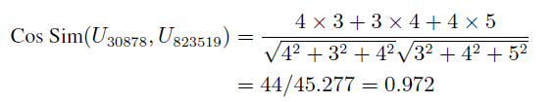
Cosine similarity is another possible measure
Use raw ratings instead of departures from averages:
Ranges from 0 (no similarity) to 1 (perfect match)
Source: Data Mining for Business Analytics (3rd ed.) by Shmueli, Bruce & Patel

Slide 28
User Based Collaborative Filtering
Calculate similarity for all possible user combinations
The highest k positively correlated users represents the most similar users
Recommend movies based on the movies with the highest average score of most similar k users that current user has not seen
Can also use a weighted average to score ratings of closer users higher

Slide 29
Example
PearsonCorrelation.xlsx

Slide 30
Example
Tiny Netflix

